Slide 1
I am most likely to look at my reflection when I am relaxed.
By: Noah Foilb

Slide 2

Why?
Every day of the week is filled with activities and education with little time to spare. So when you are tasked to try and remember to count the number of times you notice your own reflection seems difficult. It may be safe to assume that when I am relaxed is when I notice my reflection the most, which can clearly be shown by my data.

Slide 3
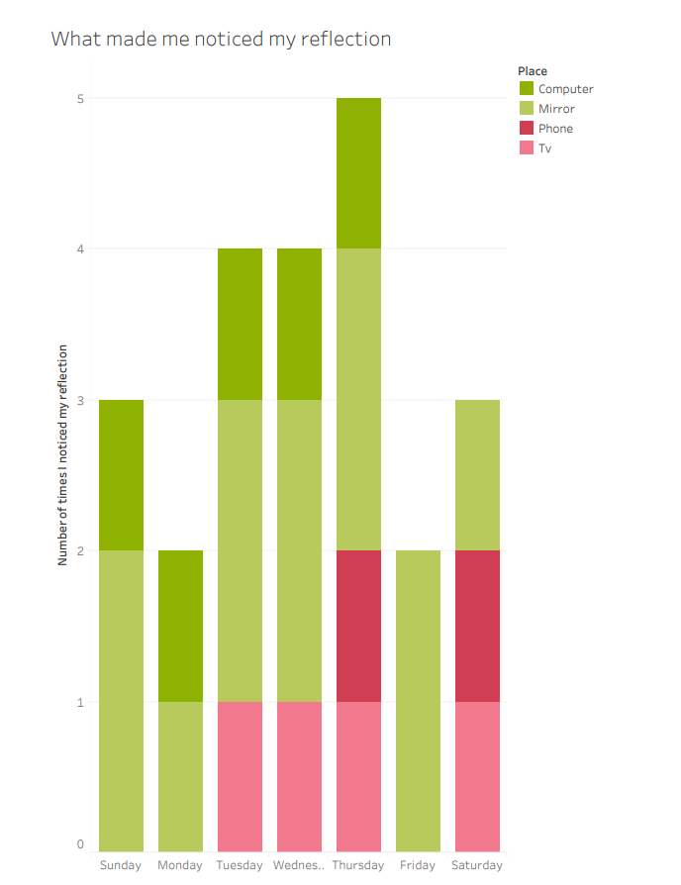
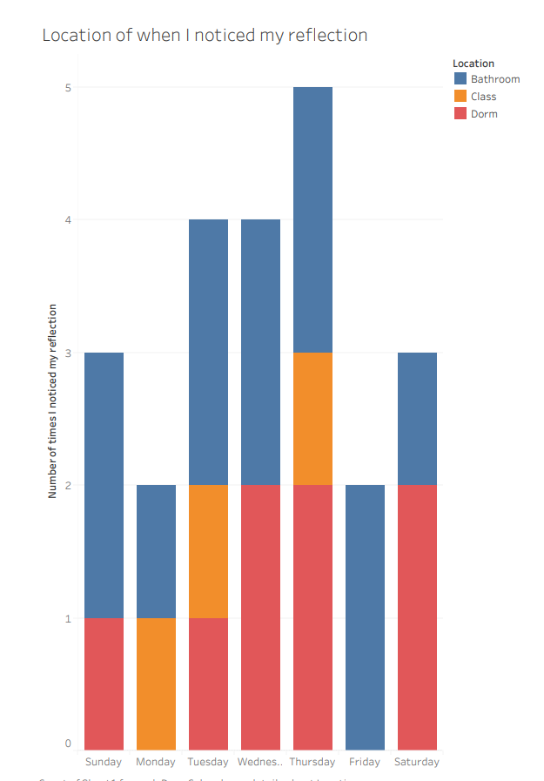
By looking at this data I can conclude that the times I notice my reflection the most when:
I am in the bathroom/ looking at the mirror.
I am on my computer.

Slide 4

Why am I relaxed when I use my computer?
When I use my computer it is usually for free time and time for me to start to wind down for the day. Moments like that is when I realize my reflection off my computer.

Slide 5

Why am I relaxed when go to the bathroom?
Usually when I notice my reflection in the bathroom is when I am brushing my teeth or taking a shower. For me I am usually relaxed when I take a shower because that tends to be the end of my day.

